Slide 1
Study Designs
CHAPTER 2

Slide 2
Learning Objectives (1 of 2)
List and define the components of a good study design
Compare and contrast observational and experimental study designs
Summarize the advantages and disadvantages of alternative study designs

Slide 3
Learning Objectives (1 of 2)
Describe the key features of a randomized controlled trial
Identify the study designs used in public health and medical studies

Slide 4
Study Designs
Observational studies
Case report/case series
Cross-sectional (prevalence) survey
Case-control study
Cohort study
Experimental studies
Randomized controlled (clinical) trial

Slide 5
Inferences
Observational studies—inferences limited to descriptions and associations; with carefully designed analysis, can make stronger inferences (statistical adjustment)
Experimental studies—cause and effect
In all studies—need careful definition of disease (outcome) and exposure (risk factor)

Slide 6
Which Design Is Best?
Depends on the study question
What is current knowledge on topic?
How common is disease (and risk factors)?
How long would study take; what are costs?
Ethical issues

Slide 7
Case Report/Case Series
Observational study
Case report—detailed report of specific features of case
Case series—systematic review of common features of a small number of cases
Advantage: cost-efficient
Disadvantages: no comparison group, no specific research question

Slide 8
Case Series (1 of 2)
Simplest design—description of interesting observations in a small number of individuals
Usually case series do not involve control patients (i.e., patients free of disease)
Usually lead to generation of hypotheses for more formal testing
Criticisms: not planned, no research hypotheses

Slide 9
Case Series (2 of 2)
Gottleib (1981) studied five young homosexual men with rare form of pneumonia and other unusual infections.
Initial report was followed by more series (26 cases in NY and CA; “cluster” in southern CA; 34 cases among Haitians, etc.)
Condition termed AIDS in 1982.

Slide 10
Cross-Sectional Survey (1 of 2)
Observational study conducted at a point in time
Advantages: cost-efficient, easy to implement, ethical
Disadvantages: no temporal information, non-response bias

Slide 11
Cross-Sectional Survey (2 of 2)
Is there an association between diabetes and cardiovascular disease (CVD)?
Patients with Diabetes
Patients without Diabetes
Patients with CVD

Slide 12
Prospective Cohort Study
Observational study involving a group (cohort) of individuals who meet inclusion criteria followed prospectively in time for risk factor and outcome information
Advantages: can assess temporal relationships
Disadvantages: need large numbers for rare outcomes, confounding

Slide 13
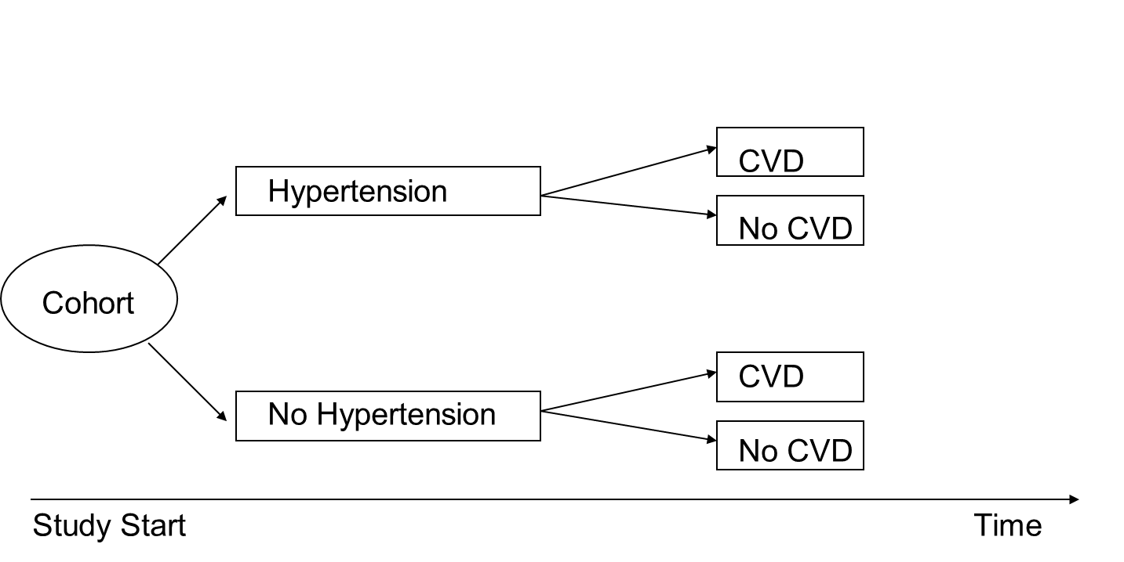
Cohort Study (1 of 3)
Is there an association between hypertension and cardiovascular disease?

Slide 14
Cohort Study (2 of 3)
Identify a group of individuals that meet inclusion criteria.
Follow prospectively in time.
Assess exposure.
Evaluate outcome status.

Slide 15
Cohort Study (3 of 3)
Includes persons exposed and not exposed to risk factor at outset—usually persons are disease free.
Can assess temporal relationship
Problem if disease is rare (small numbers)
Bias is less of an issue than in case-control.
Confounding may be a problem.

Slide 16
The Framingham Heart Study
5000+ men and women enrolled in 1948
Longitudinal cohort study
Exams every 2 years for cardiovascular risk factors—surveillance
Ancillary studies—hearing, exercise, nutrition, neurological studies
5000+ offspring and spouses enrolled in 1976
Third generation enrolled in 2002

Slide 17
Selection of Study Sample
Exposure group
Common risk factors—general population (e.g., Framingham Study)
Rare risk factors—special exposure cohort (e.g., soldiers exposed to agent orange)
Comparison group
Similar on all other factors that might affect outcome

Slide 18
Case-Control Study (1 of 3)
Observational study involving individuals with (cases) and without (controls) outcome of interest
Advantages: cost and time efficient for rare outcomes
Disadvantages: need careful selection of cases and controls, bias

Slide 19
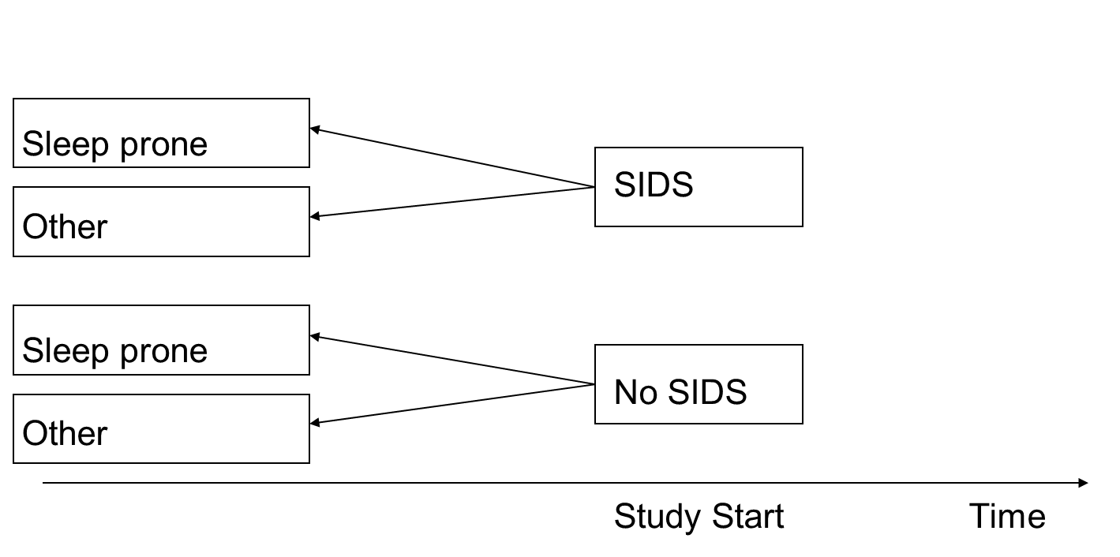
Case-Control Study (2 of 3)
Is there an association between sleep position and sudden infant death syndrome (SIDS)?

Slide 20
Case-Control Study (3 of 3)
Select subjects on the basis of outcome.
Cases have disease.
Controls are free of disease.
Compare groups with respect to proportions with a history of exposure (possible cause).
Investigation is retrospective in time.

Slide 21
Sampling
Selection of cases
Need explicit definition to make cases as homogeneous as possible
Debate over whether cases should represent all persons with disease or specific subgroup (limit inferences)
Selection of controls
Should be comparable to cases (same exclusions)
Controls represent non-diseased persons who would have been included as cases if they had disease.

Slide 22
Features
Retrospective design
Cost and time efficient
Can get sufficient number of cases (useful for rare conditions)
Can investigate array of exposures
Best for diseases with long latency

Slide 23
Issues
Ascertainment of exposure and disease status
Both exposure and disease have occurred—hard to establish temporal relationship
Bias
Selection bias—select cases or controls and some drop out, leaving groups not comparable
Observation bias—knowledge of disease might influence reporting of exposure (over-reporting among cases)
Recall bias—retrospective (long term)

Slide 24
Randomized Control Trial (1 of 2)
Experimental study where patients are randomized to receive one of several comparison treatments
Advantages: gold standard from a statistical point of view, minimizes bias and confounding
Disadvantages: expensive, requires extensive monitoring, inclusion criteria can limit generalizability

Slide 25
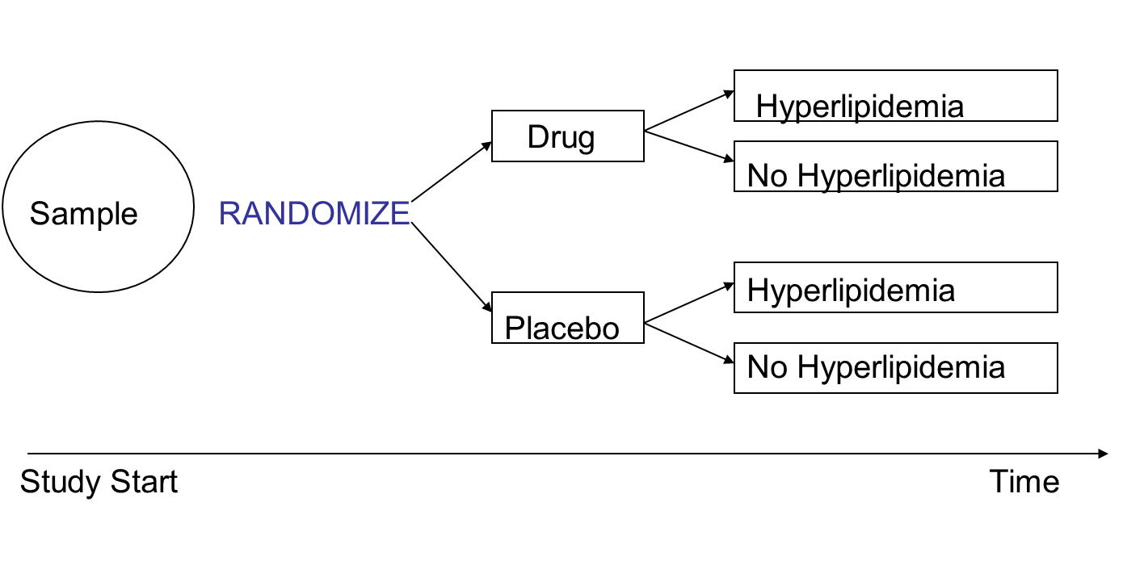
Randomized Control Trial (2 of 2)
Is new drug effective in reducing hyperlipidemia (high total serum cholesterol)?

Slide 26
Randomized Controlled Trial (Clinical Trial)
Subjects are randomized to one of two (or more) treatments, one of which may be a control treatment.
In the long run, treatment groups will be balanced in known and unknown prognostic factors.
Important that the treatments are concurrent—that the active and control treatments occur in the same period of time
Single- versus multicenter

Slide 27
Features
If possible, a study should be double blinded—neither the investigator nor the participant are aware of what treatment the participant is undergoing.
Sometimes it is impossible to blind the participants (for example, when the treatments being compared are medical versus surgical); but often it is possible to ensure that the people evaluating the outcome are unaware of the treatment.

Slide 28
Phase I: Safety
First time in humans; main objective to assess toxicity and safety in humans—pharmacokinetics
Usually involves 10 to 15 patients
Subjects are usually healthy.
Some are placebo-controlled.

Slide 29
Phase II: Feasibility Study
Focus still on safety
Side effects and adverse events
Efficacy is important—goal is to determine optimal dosage.
Involves a control group, and subjects are randomized.

Slide 30
Phase III: Clinical Trial
Focus is efficacy.
Data are collected to monitor safety.
Involves a control group (placebo, active control)
Usually involves 200 to 500 subjects
Subjects are randomized.
At least two centers

Slide 31
Phase IV: Post-Marketing
After approval by FDA (based on efficacy proven statistically in two or more studies, New Drug Application (NDA) reviewed within 1 year)
Focus is effectiveness.

Slide 32
Critical Components of RCT
Randomization
Control group—ethical issues
Monitoring
Interim analysis
Data and safety monitoring board
Data management
Reporting

